Slide 1
Data Warehouse Dimensional modeling
Dr. Laila abdel hamid
Dr. Mai El Defrawi
2021 - 2022

Slide 2
References
https://www.guru99.com/dimensional-model-data-warehouse.html

Slide 3
Dimensional modeling
IS a data structure technique optimized for data storage in a Data warehouse.
The purpose of dimensional modeling is to optimize the database for faster retrieval of data.
The concept of Dimensional Modelling was developed by Ralph Kimball and consists of “fact” and “dimension” tables.
Dimensional modeling is a technique for structuring data around the business concepts

Slide 4
Dimensional modeling and Relational data model
A dimensional model in data warehouse is designed to read, summarize, analyze numeric information like values, balances, counts, weights, etc. in a data warehouse.
In contrast, relation models are optimized for addition, updating and deletion of data in a real-time Online Transaction System.
For instance, in the relational mode, normalization and ER models reduce redundancy in data. On the contrary, dimensional model in data warehouse arranges data in such a way that it is easier to retrieve information and generate reports.

Slide 5
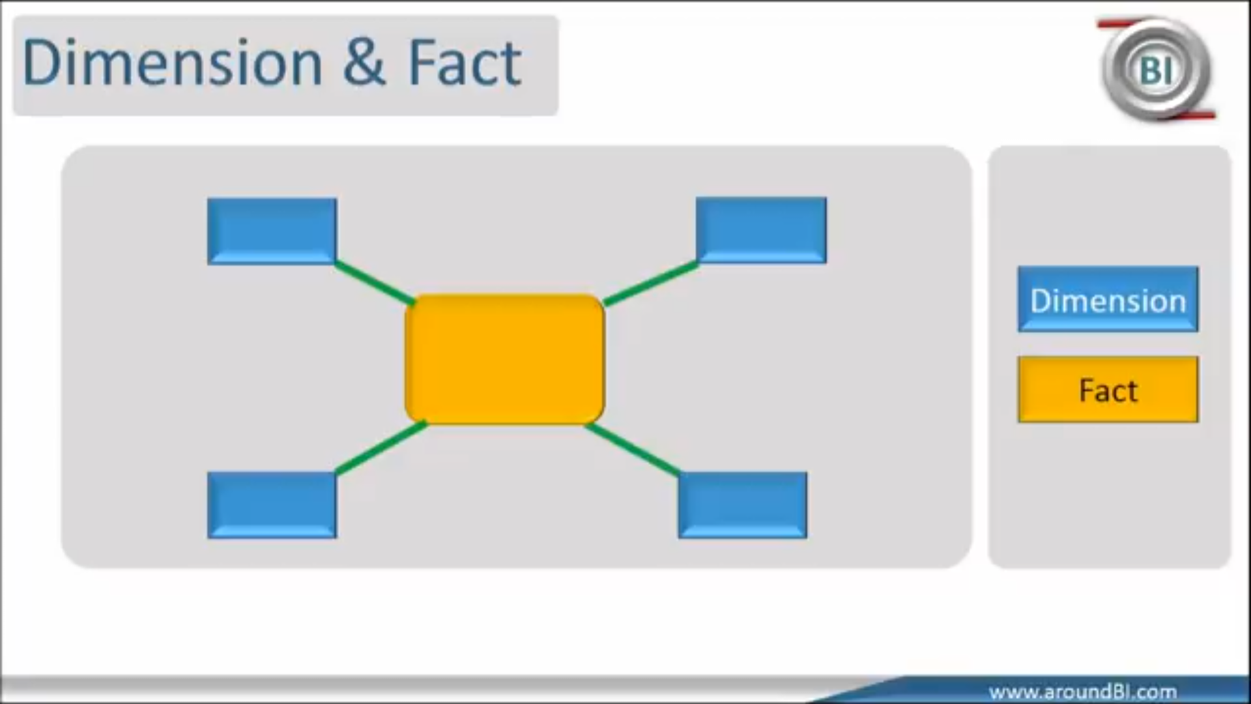
Building Blocks

Slide 6
Elements of Dimensional Data Model
Fact
Facts are the measurements/metrics or facts from your business process. For a Sales business process, a measurement would be quarterly sales number
Dimension
Dimension provides the context surrounding a business process event. In simple terms, they give who, what, where of a fact. In the Sales business process, for the fact quarterly sales number, dimensions would be
Who – Customer Names
Where – Location
What – Product Name
In other words, a dimension is a window to view information in the facts.

Slide 7
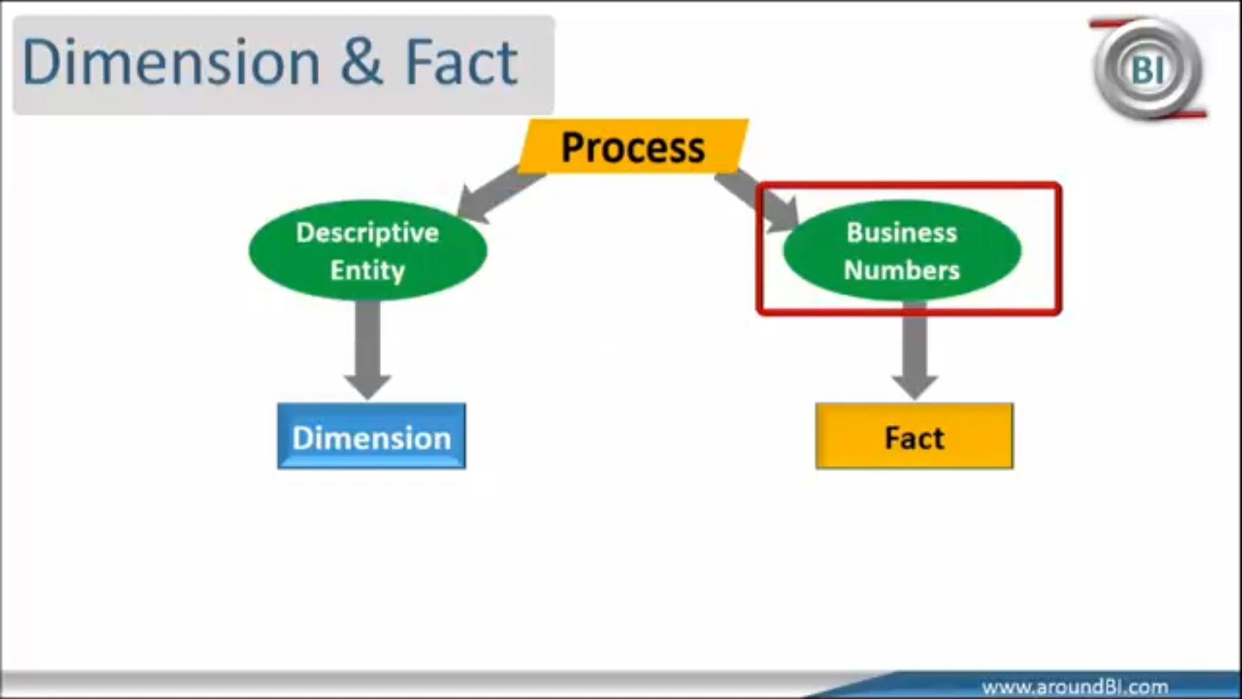

Slide 8
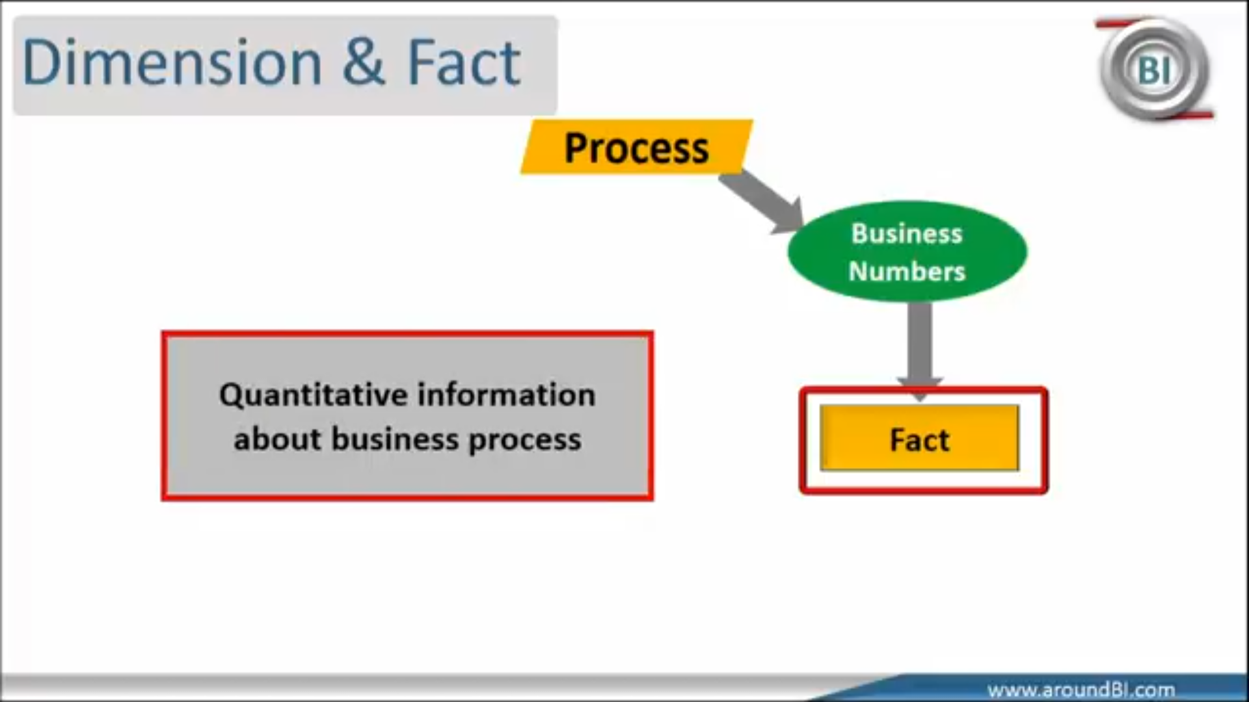

Slide 9
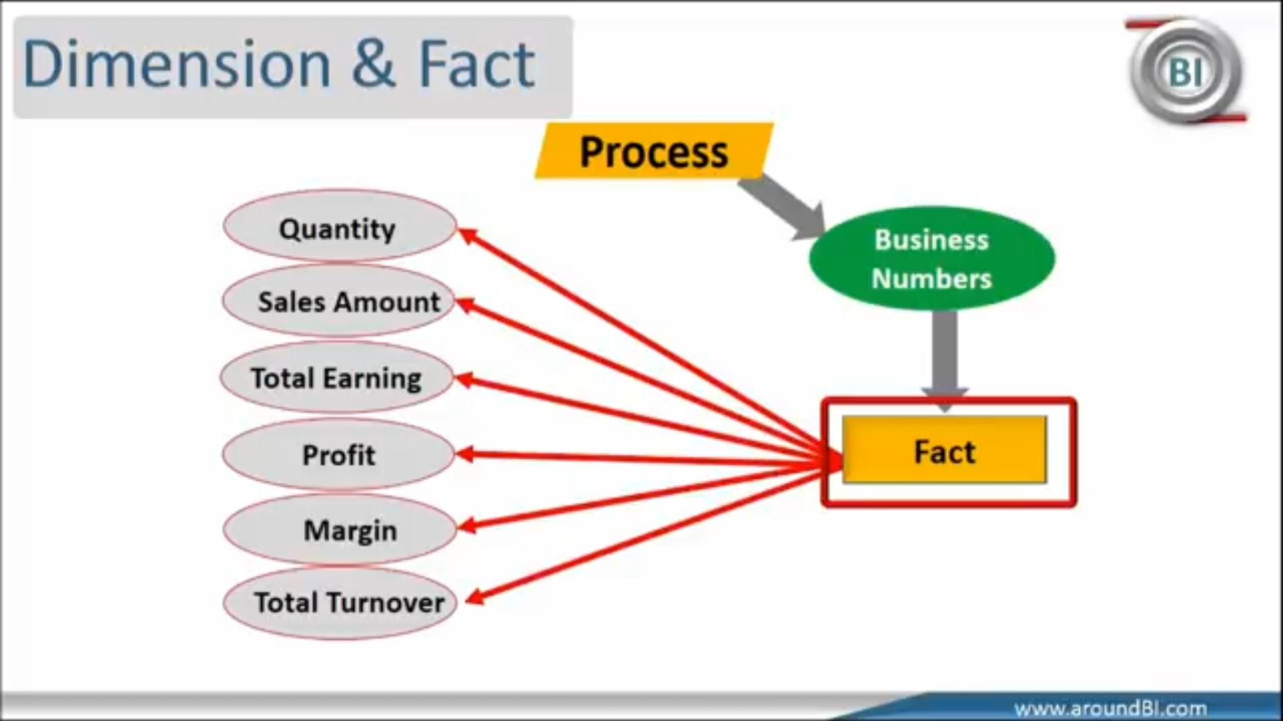

Slide 10
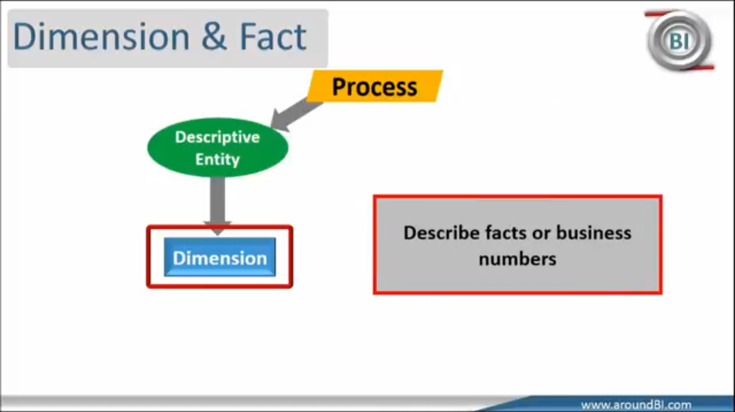

Slide 11
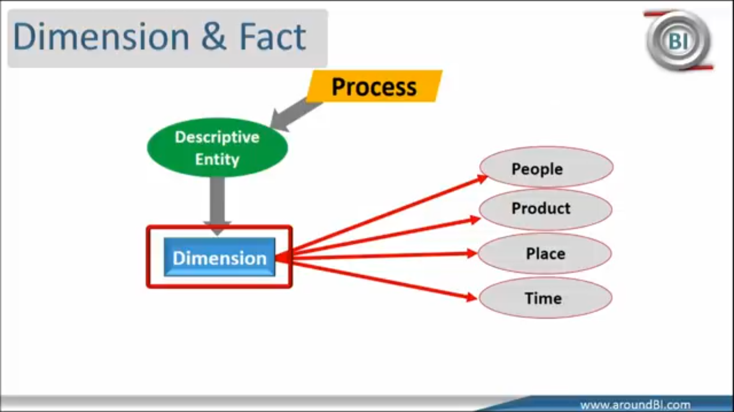

Slide 12
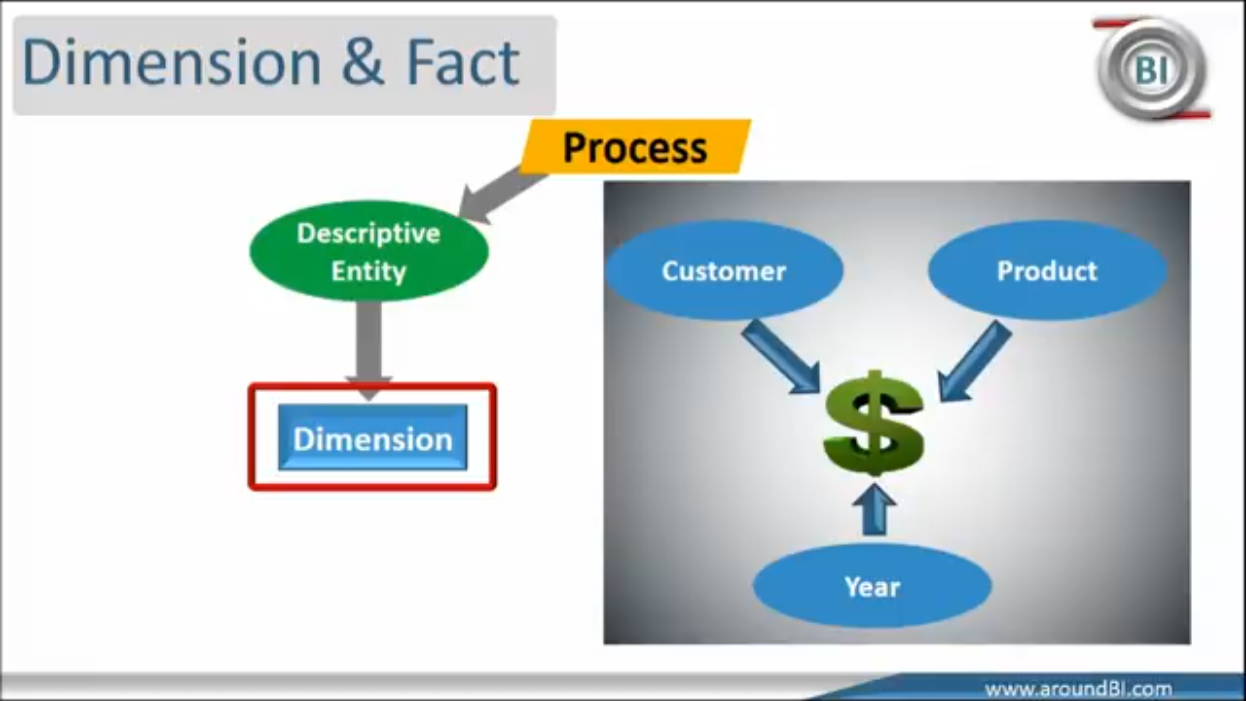

Slide 13
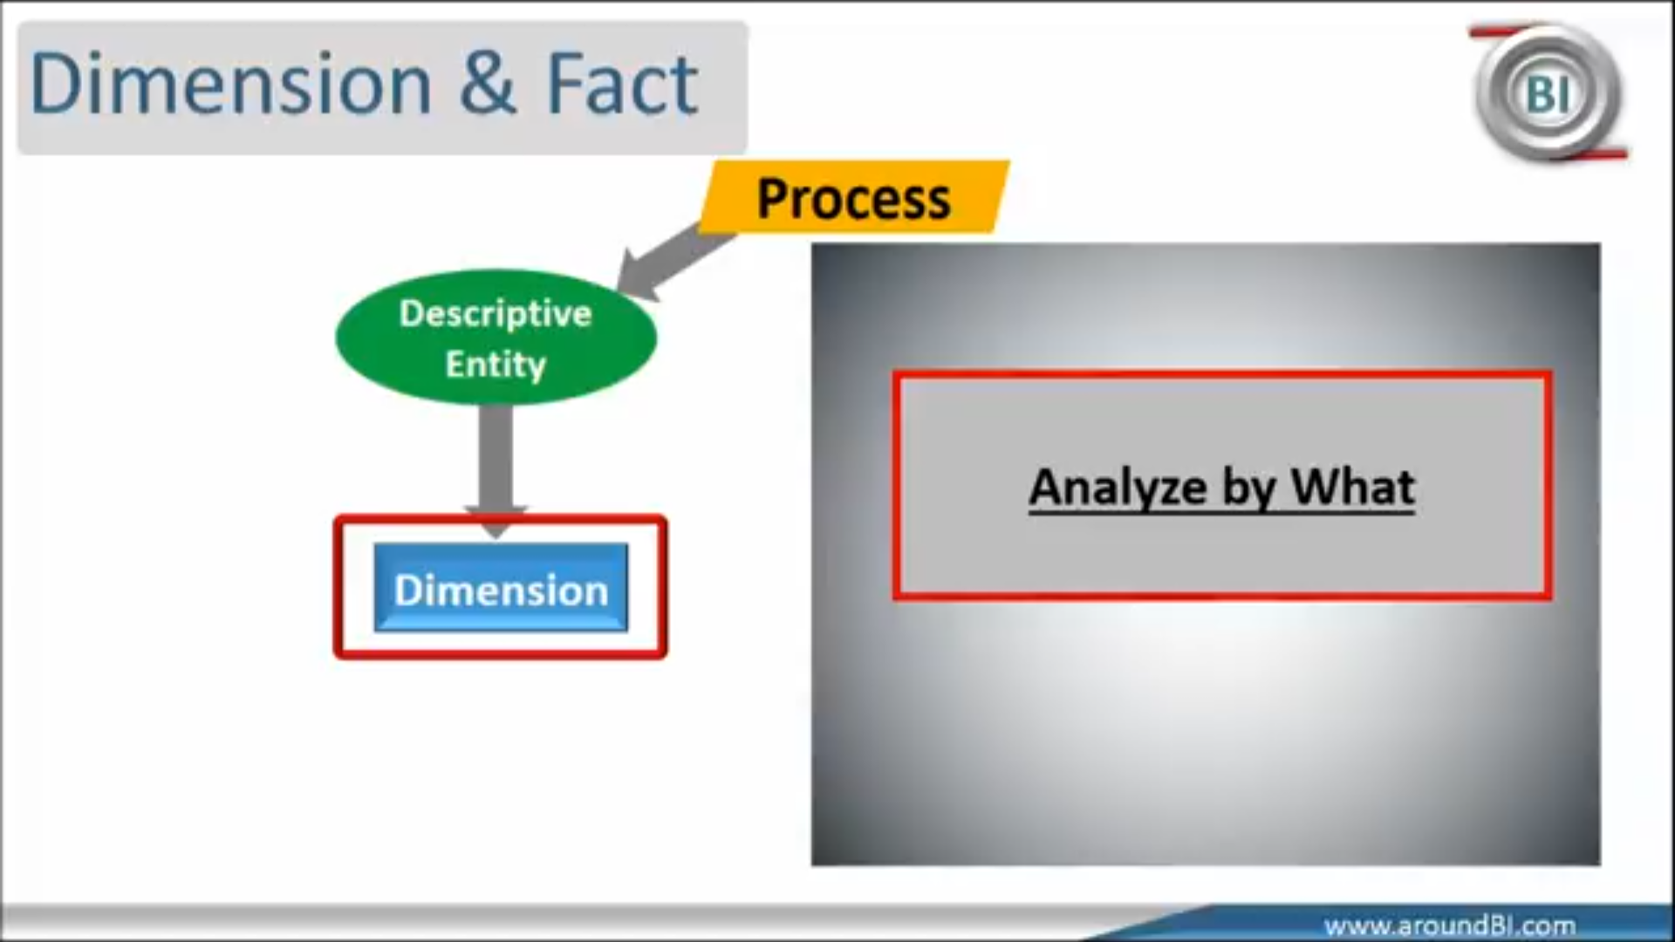

Slide 14
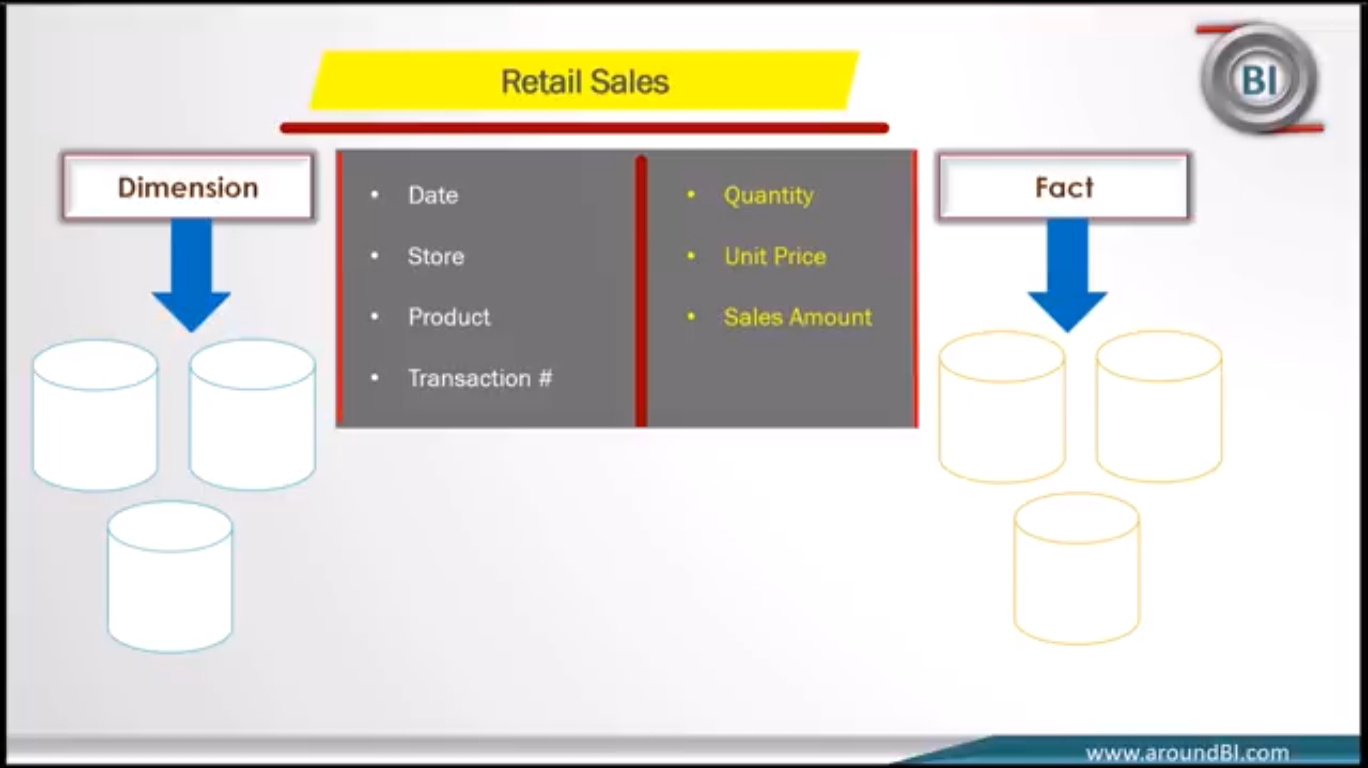

Slide 15
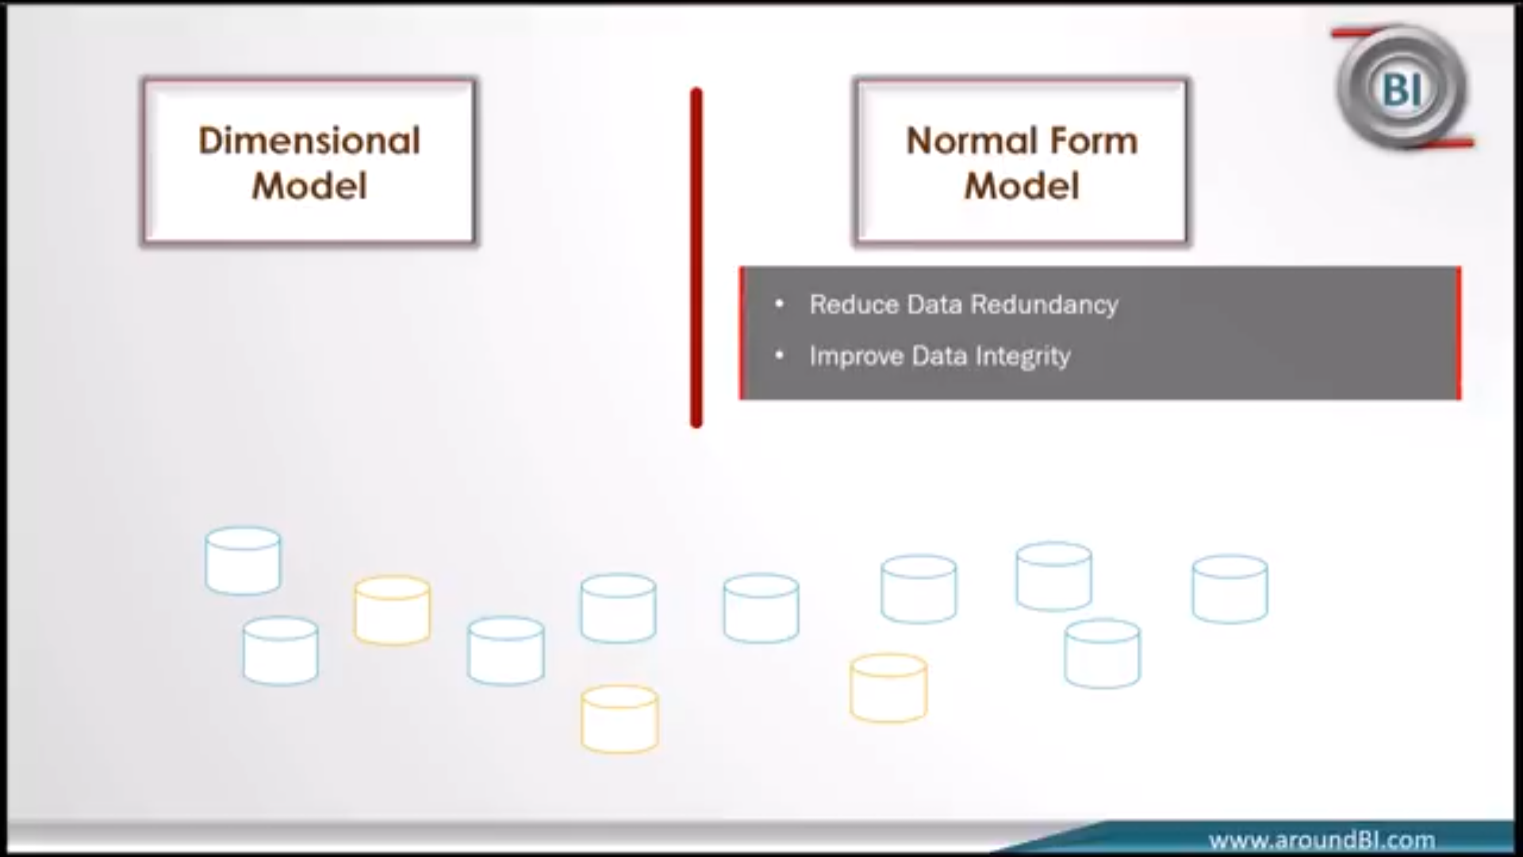
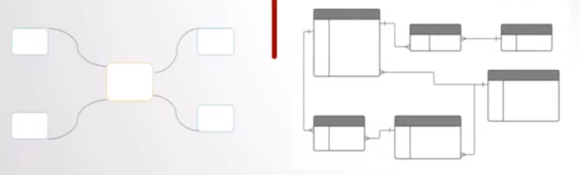
Dimensional Model vs. Normal Form

Slide 16
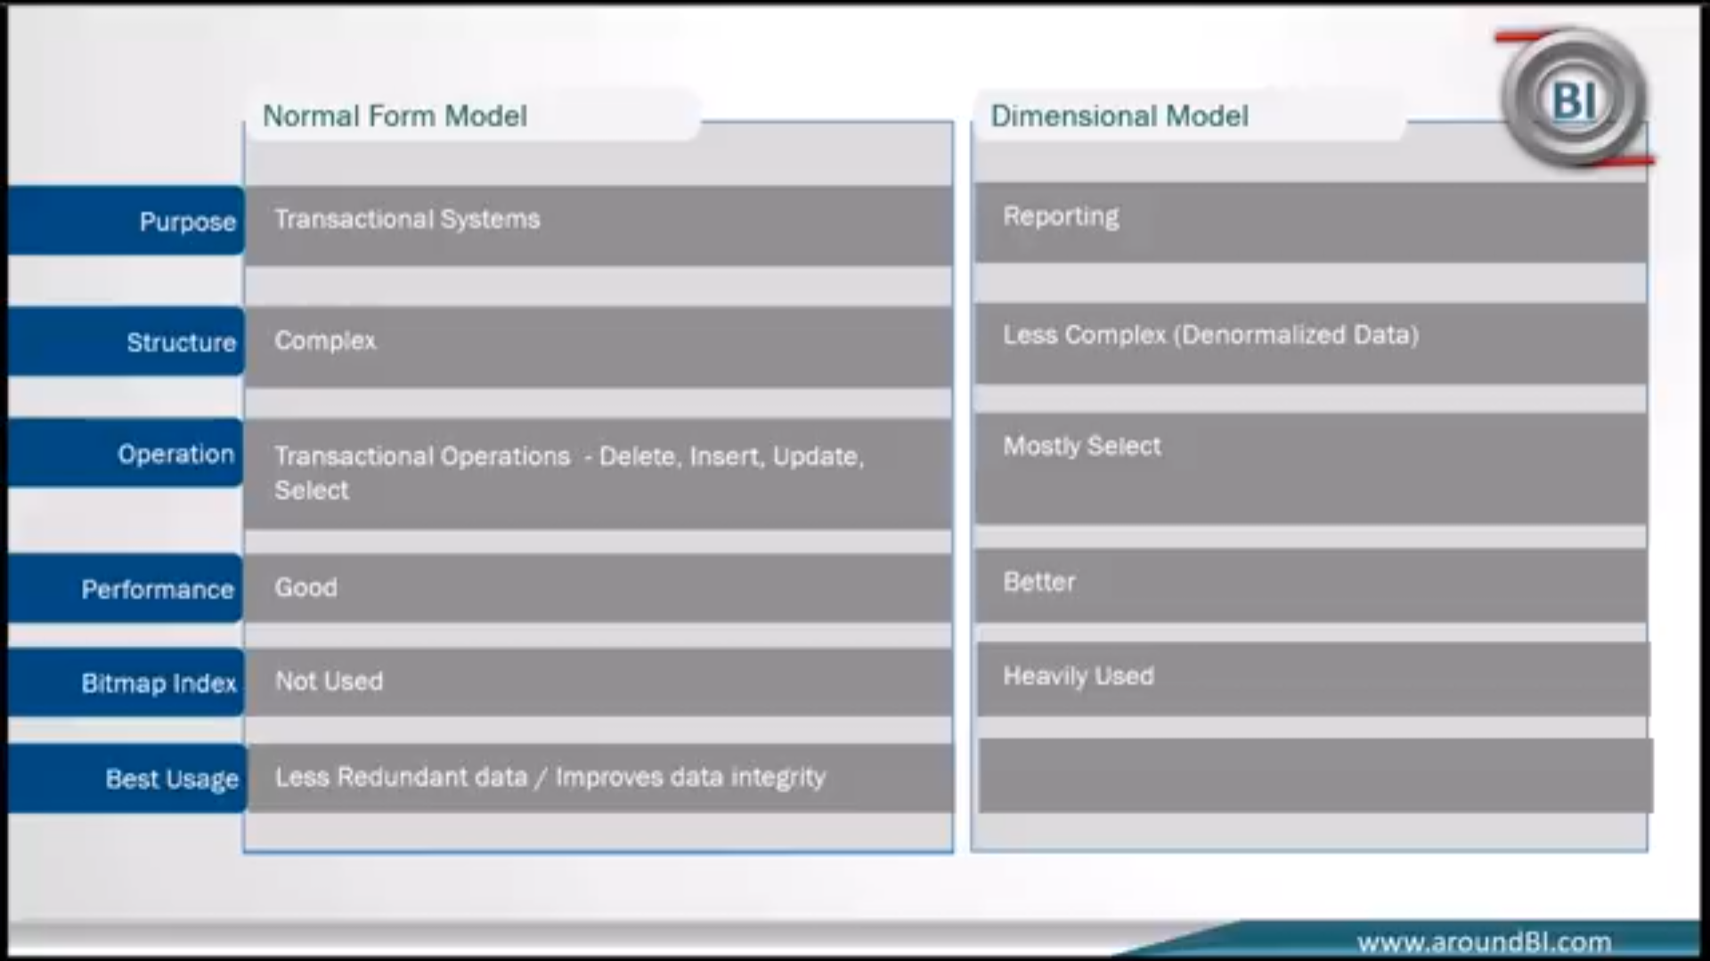

Slide 17
Cont.
Attributes
The Attributes are the various characteristics of the dimension in dimensional data modeling.
In the Location dimension, the attributes can be
State
Country
Zipcode etc.
Attributes are used to search, filter, or classify facts.
Dimension Tables contain Attributes

Slide 18
Cont.
Fact Table
A fact table is a primary table in dimension modelling.
A Fact Table contains
Measurements/facts
Foreign key to dimension table
Dimension Table
A dimension table contains dimensions of a fact.
They are joined to fact table via a foreign key.
Dimension tables are de-normalized tables.
The Dimension Attributes are the various columns in a dimension table
Dimensions offers descriptive characteristics of the facts with the help of their attributes
No set limit set for given for number of dimensions
The dimension can also contain one or more hierarchical relationships

Slide 19
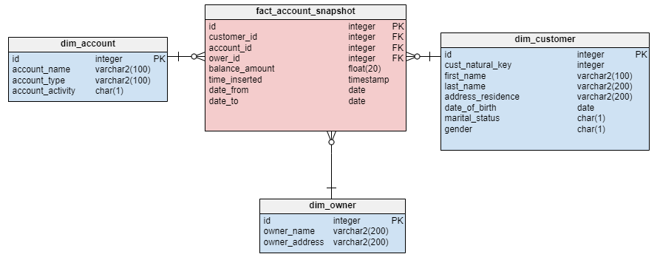
Example:

Slide 20
Types of dimensional tables
conformed dimensions
role-playing dimensions
slowly changing dimensions
junk dimensions

Slide 21
Conformed Dimensions
A conformed dimension can be associated with different fact tables, maintaining the same meaning with all of them.
In constellation-type data warehouse designs with multiple fact tables, conformed dimensions make cross-domain queries possible.
Example:
A typical conformed dimension is the date. Its meaning does not vary by fact table. For this reason, most data warehouses have a single date dimension shared by all fact tables.

Slide 22
Role-Playing Dimensions
Role-playing dimensions are used by different fact tables, just like conformed dimensions.
But unlike conformed dimensions, they have different meanings depending on the fact table or even the field within the fact table.
Example:
The date dimension, mentioned earlier as a conformed dimension, can be a role-playing dimension if we relate the same table to different date attributes.
For example, in the sales fact table, we may have an order date, a delivery date, and a payment date, all related to the same date dimension.

Slide 23
Slowly-Changing Dimensions (SCDs)
No update. This strategy is applied to immutable dimensions such as most date-type dimensions.
Attributes are always updated to the most recent value. All events referring to the dimension are associated with the most recent values of its attributes, no matter when they occur.
Changes to a dimension are applied by generating new versions of the changed elements, either by adding records that include an effective date, by mini dimensional tables, or by adding fields to differentiate the new data from the original data.

Slide 24
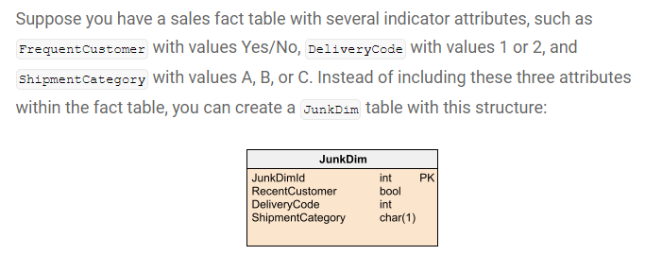
Junk Dimensions
In a data warehouse design, facts often have indicator attributes like flags, Boolean values, or some other set of values that do not make sense as a dimension because of their low cardinalities.
To avoid creating small dimensions for each of these attributes and increasing the number and sizes of the fact tables unnecessarily, a junk dimension is often created to gather all these attributes into a single table.

